Slide 1
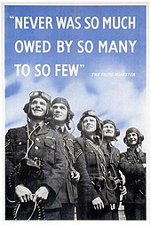
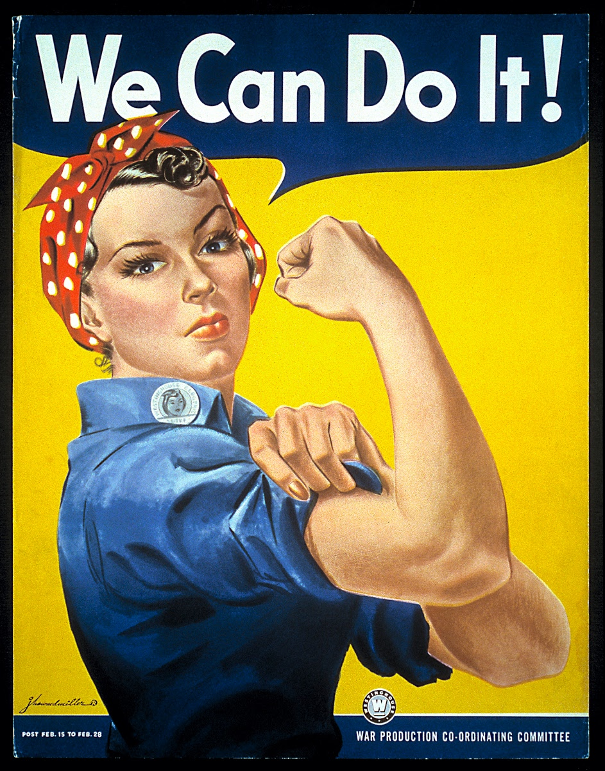
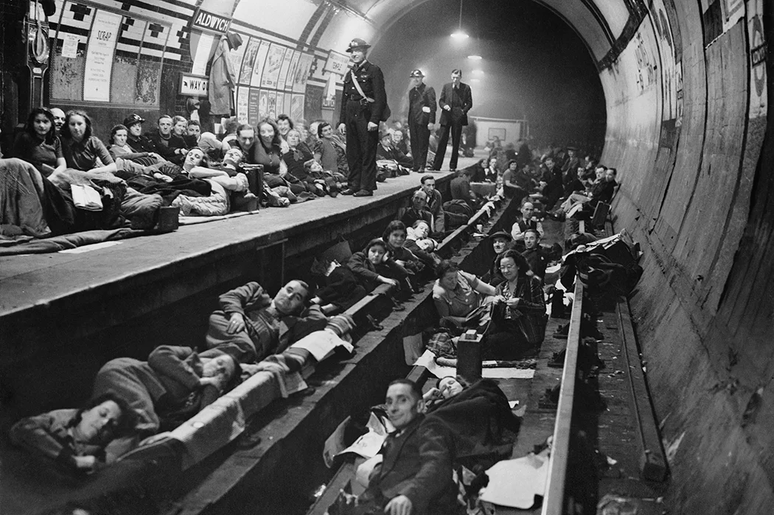
WW2: What positive legacies can we still see today? | Year 6 History | Spring 2
I should already know…
1 | Understand what ‘legacy’ is.
2 | There was lots of migration following WW2
3 | What kinder transport was
4 | A primary source is created at the time of the study and a secondary source is created after it
Significant people
Elizabeth II (1926-2022) | Princess Elizabeth was just 13 years old when war broke out on September 3, 1939. Along with her sister, she was sent to Windsor Castle, approximately 20 miles outside of London.
Winston Churchill (1874-1965) | Prime Minister of the UK from 1940-1945 (for the majority of WW2). He was responsible for making many difficult decisions during this time.
Vocabulary
Blitz | Intense bombing campaign undertaken by Nazi Germany against the UK during WW2.
Propaganda | Information, especially of a biased nature, used to promote a political cause or point of view.
Home front | Covers the activities of the civilians of the home country in a nation at war
Legacy | The long-lasting impact of particular events, actions, etc. that took place in the past.
Commemoration | A ceremony/ celebration in which people and events are remembered.
Infrastructure | The fundamental facilities and systems serving a country, city, or other area
Dictator | An individual who has total power over a country, typically one who has obtained control by force.
Allies | The countries (including Britain, France and USA) who joined together against Hitler’s Nazi party in WW2
Battle of Britain | The series of aerial combats that took place between British and German aircraft during the autumn of 1940 and that included the severe bombardment of British cities
By the end of this unit I will
1 | Understand the reasons behind Britain going to war
2 | Understand the role of the Home Front during WW2.
3 | Understand the significance of The Battle of Britain
4 | Understand the impact of bombing on cities and communities during the Blitz.
5 | Understand how to use historical data to raise and answer questions about evacuation
6 | Understand the positive legacies of the Blitz and WW2 and the importance of remembrance and commemoration.
7 | Evaluate relevant WW2 artefacts (trip to IWM)
TIMELINE – WW2
Jan 30th 1939 | Sept 1st 1939 | Sept 3rd 1939 | 10th May 1940 | May 14th 1940 | 10th July 1940 | 7th Sept 1940 | Nov 14th 1940 | 29th December 1940 | March 12th 1941 | 11th May 1941 | 6th June 1944 | 30th April 1945 | 7th May 1945 | 8th May 1945
Adolf Hitler becomes Chancellor of Germany. His Nazi Party, or the Third Reich, takes power | Germany invades Poland – WW2 begins | France and Britain declare war on Germany | Winston Churchill becomes Prime Minister | Home guard is formed | Battle of Britain begins | First night of the Blitz in London | Luftwaffe bombs Coventry as well as London | The heaviest night of bombing on London. | British defences improve | Hitler abandons the Blitz to redeploy the Luftwaffe in preparation to invade Russia. | D-Day | Hitler Commits suicide | Germany surrenders to the allies | VE day

