Slide 1
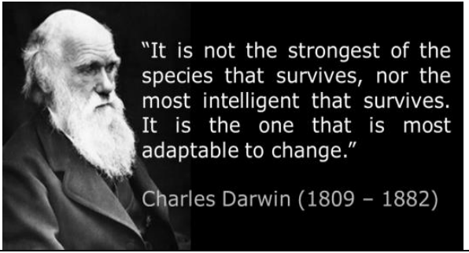
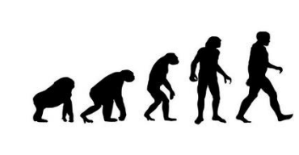
Evolution and Inheritance | Summer 1 | Year 6
What I should already know:
1 | Fossils are simply the preserved remains of an animal or plant that lived millions of years ago.
2 | That fossils are formed when things that have lived are trapped within rock.
3 | How to describe the life process of reproduction in some plants and animals.
4 | That environments can change and that this can sometimes pose dangers to living things.
Working scientifically skills:
1 | Identify scientific evidence that has been used to support or refute ideas or arguments.
2 | Observing and raising questions about animals and how they are adapted to their environment.
Key Vocabulary:
1 | Adaptation | Any physical or behavioural characteristics of an animal that help it to survive in its environment.
2 | Evolution | The process by which living things can gradually change over time.
3 | Fossil | Imprints of long dead plants and animals found in rocks.
4 | Inherited | The way that a trait or characteristic is passed to offspring from parents.
5 | Natural selection | A process in which living things adapt themselves in order to survive, that they don’t have any control over.
6 | Variety | Differences between things as part of a whole group
7 | Naturalist | A type of scientist who focuses on natural history, which is the study of living things.
Scientists/Inventors:
Mary Anning (1799 - 1847) | Mary Anning was a famous fossil hunter and collector. She found and identified many pre-historic fossils from the time of the dinosaurs.
Charles Darwin (1809 - 1882) | Charles Darwin was an English naturalist and was famous for his work on evolution and natural selection.
What I will Learn:
1 | That living things have changed over time.
2 | That fossils provide information about living things that inhabited the Earth millions of years ago.
3 | That living things produce offspring of the same kind, but normally offspring vary and are not identical to their parents.
4 | To identify how animals and plants are adapted to suit their environment in different ways.
5 | That adaptation may lead to evolution.

