Slide 1
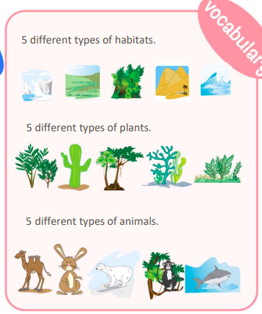
Habitat| Year 4 French | Summer 2
Phonics and Pronunciation
é | sound in: • désert
e | sound in: • le
eau | sound in: • chameau
Silent letters | There are many last consonant silent letters in French. The final ‘s’ is silent in the words ‘habitats’ and ‘grands’. The ‘t’ is silent in ‘désert’.
guttural ’r’ | The ‘r’ sound in French is guttural from the back of the throat like in the word ‘ours’.
By the end of this unit I will be able to:
1 | Say and write the key elements that animals and plants need to survive.
2 | Name the 5 most common types of habitats
3 | Name an animal and a plant that live and grow in each type of habitat.
Key Vocabulary and Phrases
1 | la prairie | the meadow
2 | l’Arctique | the Arctic
3 | la forêt tropicale | rainforest
4 | le désert | the desert
5 | l’océan | the ocean
6 | le lapin | the rabbit
7 | l’ours blanc | the polar bear
8 | le singe araignée | the spider monkey
9 | le chameau | the camel
10 | le requin | the shark
11 | l’eau | the water
12 | l’air | the air
13 | la nourriture | the food
14 | le soleil | the sun
15 | un abri | a shelter
I should already be able to:
1 | To ask ‘Where do you live?’
2 | Say and write in French whether I live in a house or an apartment.
3 | Say and write in French the nouns and determiners for 12 classroom objects.

