Slide 1
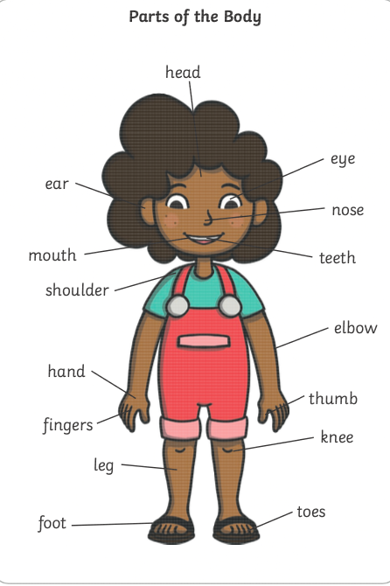
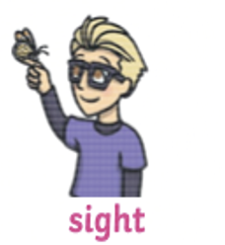


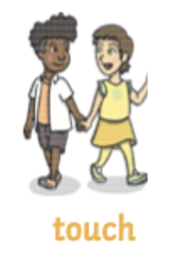

Who Am I? | Year 1 Science | Autumn 1
What I should already know:
1 | The names of some parts of my body.
2 | That I can use different parts of my body to find out about the world
The human body
Key Vocabulary:
1 | organs | A group of different tissues that work together to perform a job inside the body
2 | skeleton | The framework of a living thing that, in animals, is usually made of bone.
3 | vertebrate | Animal with a backbone
4 | senses | Five different ways of understanding and experiencing the world around us
5 | data | A collection of information
6 | pictogram | A chart that uses pictures to represent data
What I will learn:
1 | To identify and label parts of the human body
2 | Know the names of the five senses and which part of the body it’s associated with
Working Scientifically Skills: | Gather data to help answer questions.
1 | Observing closely
2 | Gathering and recording data
Senses

